Slide 1

L’Europa alla prova del Chat Control: la cifratura end-to-end come fondamento della libertà digitale
Luca Cadonici
Firenze, 23 ottobre 2025
e-privacy XXXVII (2025)
Misurare l’Umano? Dal Vitruviano all’Algoritmo

Slide 2


Europol vs E2EE
21/04/2024

Slide 3
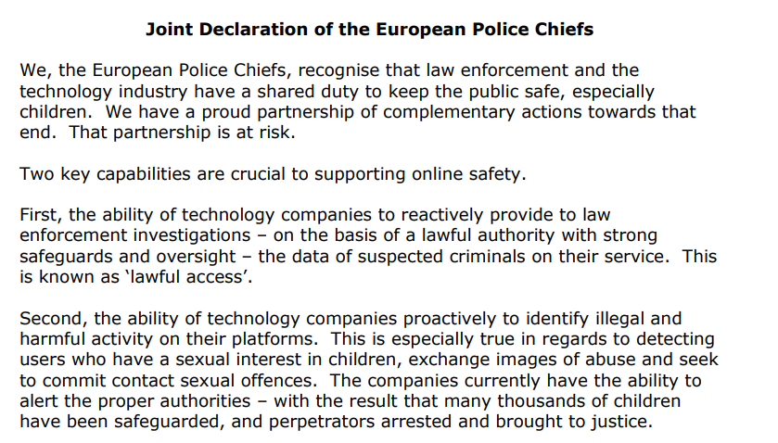
Europol vs E2EE
21/04/2024
On April 2024, Europol and European police chiefs are calling for industry and governments to take urgent action to limit end-to-end encryption (E2EE).
In a joint statement release, they criticized the strict privacy measures that tech companies like Meta are implementing for their messaging services.
https://www.europol.europa.eu/cms/sites/default/files/documents/EDOC-%231384205-v1-Joint_Declaration_of_the_European_Police_Chiefs.PDF

Slide 4


Slide 5
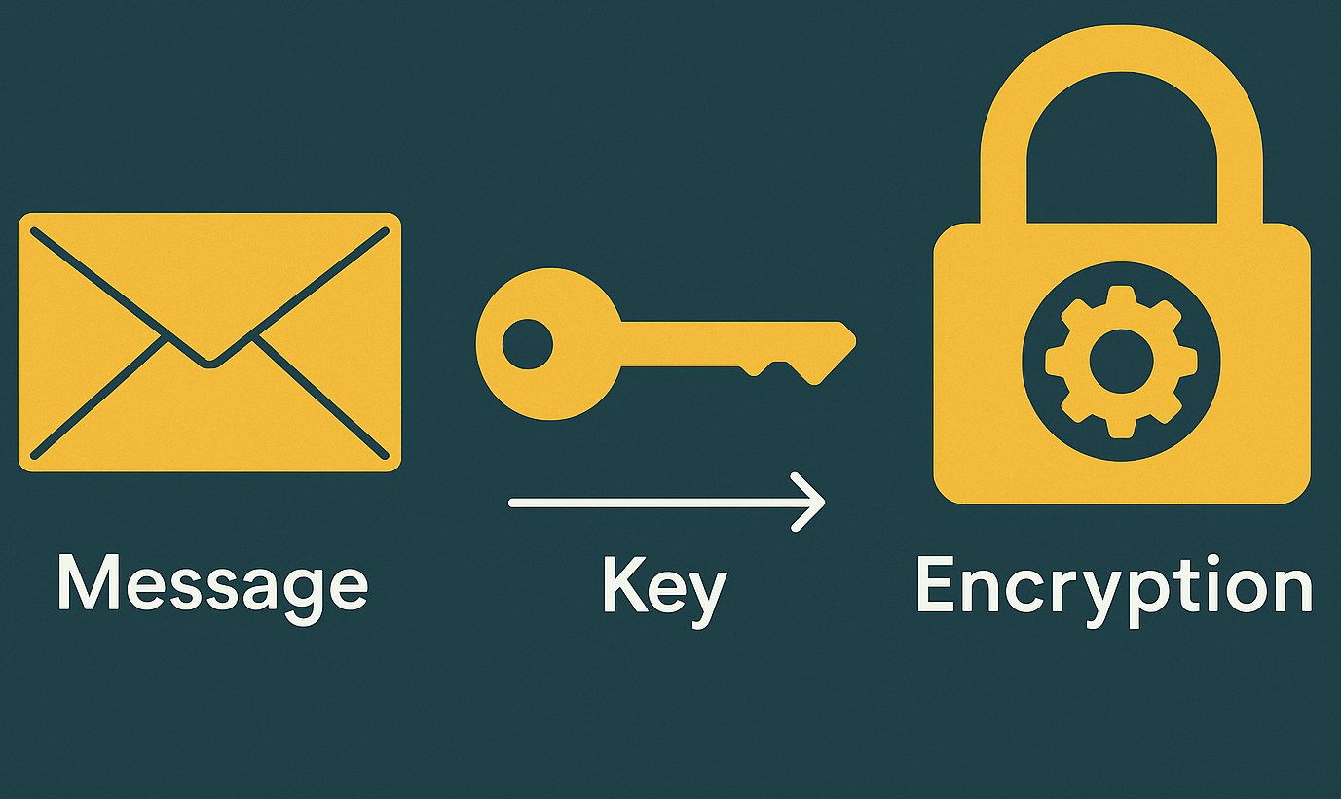
Encryption
Encryption: the process of converting data (plaintext) into an unintelligible form (cyphertext) to prevent unauthorized access.
Encryption key: a piece of information used to encrypt and decrypt data during the encryption and decryption processes, respectively.
Encryption Algorithm: a mathematical or logical procedure used to encrypt and decrypt data.

Slide 6
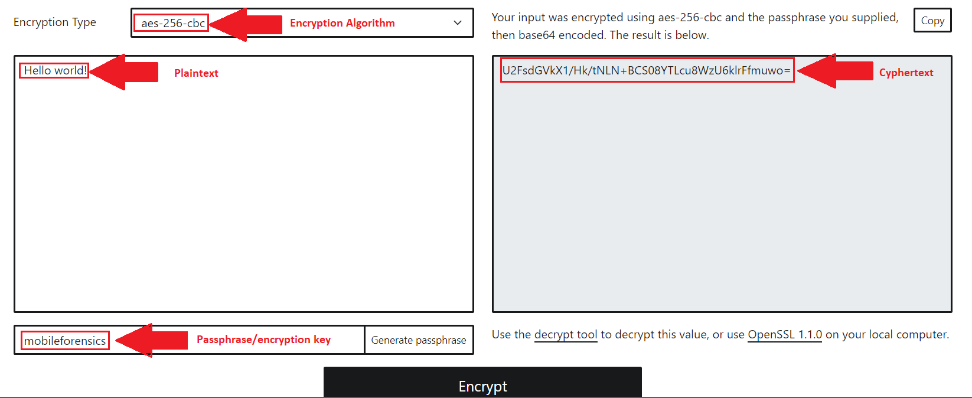
Encryption
https://encrypt-online.com/

Slide 7






End-to-End Encryption
End-to-End Encryption (E2EE) is an encryption mechanism that ensures data is encrypted by the sender and can only be decrypted by the intended recipient.
This means that no third party—including service providers, servers, or governments—can access the content of the communication, since only the end users hold the decryption keys.
Apps like WhatsApp and Signal use E2EE to protect messages, calls, and files.
Data is encrypted on the sender’s device and decrypted only on the recipient’s device, making it unreadable even to service providers facilitating the communication.

Slide 8
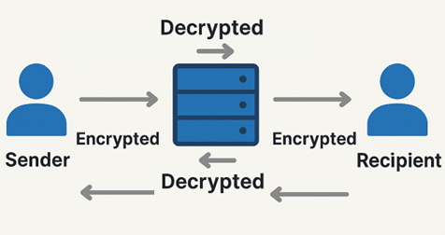
Server-based encryption
Without E2EE, a message is typically encrypted:
  during transmission from the sender to the provider’s server
  from the server to the recipient
  However, the message is usually decrypted temporarily on the provider’s server before being re-encrypted and forwarded.

Slide 9
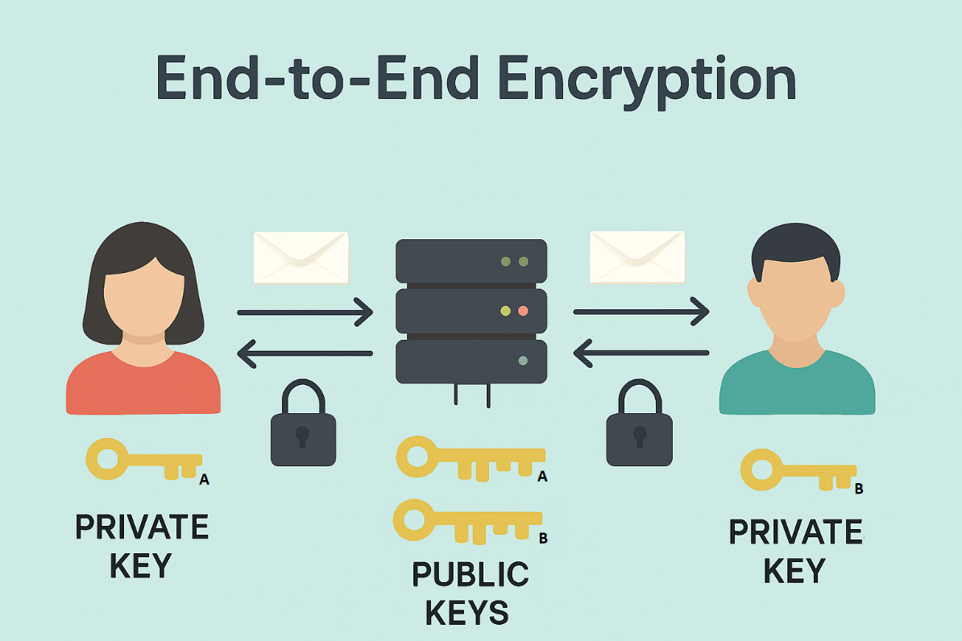
End-to-End Encryption
E2EE is different because it is impossible for anyone in the middle to decrypt the message:
Messages are encrypted on the sender’s device using the recipient’s public key
They remain encrypted while in transit and are only decrypted on the recipient’s device using their private key
Plaintext is never exposed to the provider’s servers

Slide 10
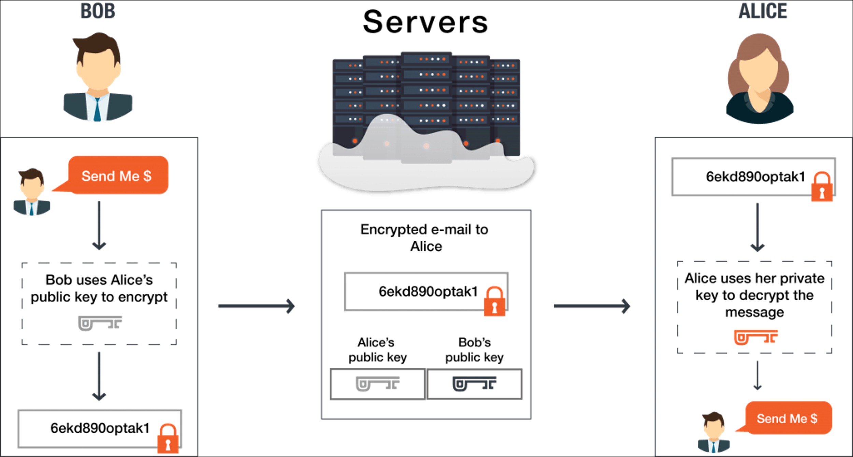
End-to-End Encryption
E2EE uses public key cryptography, where each user has:
  a public key (stored on company servers)
  a private key (kept secret on user device)
The two keys are mathematically linked:
  anything encrypted with the public key can only be decrypted with the corresponding private key.

Slide 11


End-to-End Encryption
The provider's server acts only as a relay, forwarding the encrypted message (ciphertext).
This ensures the data stays secure against cyberattacks targeting server
Even if the provider is compromised, the data remains protected.
Since only the recipient holds the private key, service providers cannot decrypt messages—even if requested to do so from Governments or LEAs.

Slide 12


Slide 13

E2EEE and lawful access
Legal and Ethical Tensions:
  Privacy advocates defend E2EE as essential for human rights.
  LEAs argues it creates “warrant-proof” zones.
Investigators cannot access message content from service providers.
Even with a warrant, platforms using E2EE could not provide plaintext data.
This tension has also played out in legal battles, yielding conflicting outcomes worldwide.

Slide 14


Facebook Messenger
(Nevada - 2024)
On December 2023 Meta has started rolling out default end-to-end encryption for personal messages and calls on Messenger and Facebook.
In February 2024, the State of Nevada is seeking an emergency restraining order to prevent Meta from implementing end-to-end encryption on Facebook Messenger for all underage users in the state.
The request for a temporary restraining order is part of a lawsuit filed by the Nevada Attorney General, who accuses Meta's products of being deceptively designed to create addiction in users.

Slide 15
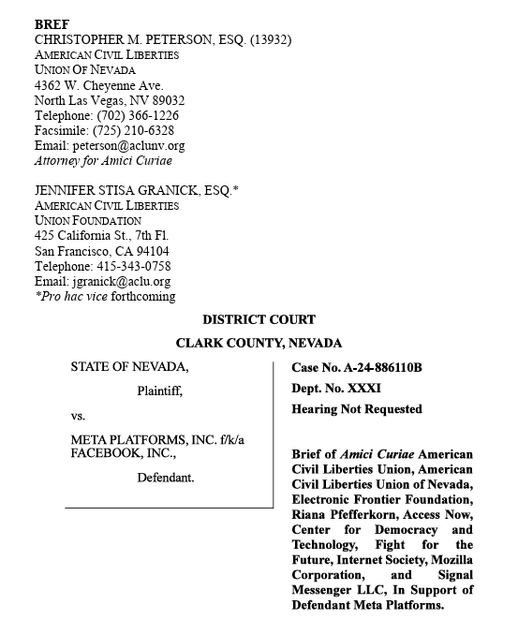
Facebook Messenger
(Nevada - 2024)
A privacy advocacy coalition including Signal, and Mozilla filed an amicus brief opposing Nevada’s attempt to block end-to-end encryption for minors:
End-to-end encryption is a fundamental tool for protecting online privacy and security, especially for minors.
Blocking encryption does not eliminate abuse; it instead exposes young people to new risks and weakens existing protections.
Investigations remain possible even with encryption, through user reports, access to devices, and other data collected by Meta.
A recent study confirms that content-oblivious investigative methods in detecting online abuse such as user reporting and metadata analysis, are often more effective.
The European Court of Human Rights recently struck down a similar Russian law, deeming it incompatible with human rights (Case of Podchasov vs Russia).
https://www.eff.org/document/nevada-v-meta-amicus-brief
Pfefferkorn, R. (2022). Content-oblivious trust and safety techniques: Results from a survey of online service providers.
Journal of Online Trust and Safety, 1(2). https://doi.org/10.54501/jots.v1i2.14

Slide 16
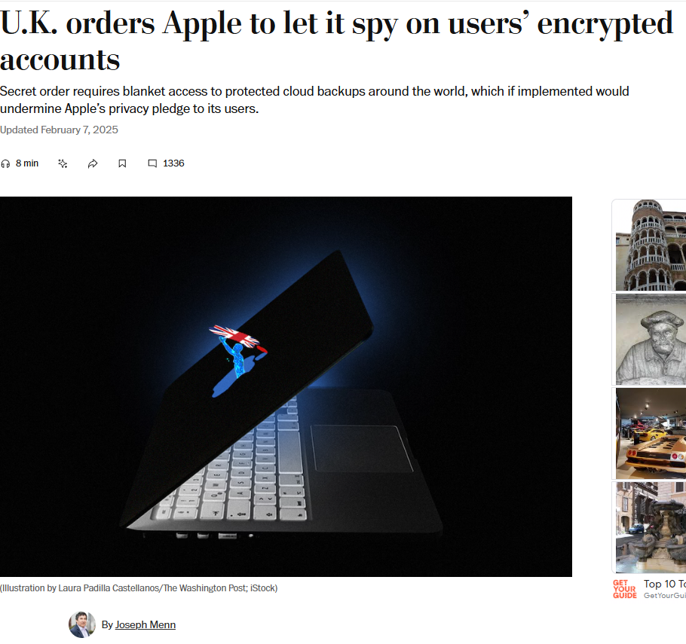
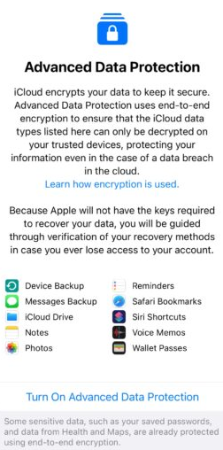
Apple - UK (February 2025)
Security officials in the United Kingdom have demanded that Apple create a backdoor allowing them to retrieve all the E2EE content any Apple user worldwide has uploaded to the cloud – so not just for U.K. users, but for international users as well.
Advanced Data Protection (ADP):is an optional Apple feature that extends E2EE to data in iCloud, making it accessible only to you on your trusted devices.

Slide 17


Apple - UK (February 2025)
Advanced Data Protection (ADP) no longer available to new U.K. users
Existing users will be required to disable ADP
Apple: “We have never built, and never will build, a backdoor”
https://support.apple.com/en-us/122234

Slide 18

EU Regulation on Child Sexual Abuse – CSA Regulation "Chat Control”
(2022 – currently under discussion)
Proposed on 11 May 2022 by EU Commissioner for Home Affairs, Ylva Johansson
  Official Objective: Prevent and combat child sexual abuse online within the EU
  The goal was to require online service providers to detect, report, and remove child sexual abuse material (CSAM).
  The proposal also sought to prevent grooming practices—the online solicitation of minors for sexual purposes.
  It further included measures to enhance support for victims of child sexual abuse.
  Known by critics as “Chat Control” because it raises significant concerns over privacy and freedom of communication.
October 2025: As member states failed to reach an agreement, the planned vote of the Council of Europe scheduled for 14 October 2025 will not take place. A revised draft may be introduced later by Denmark or another Presidency.
https://ec.europa.eu/commission/presscorner/detail/en/ip_22_2976

Slide 19
EU Regulation on Child Sexual Abuse – "Chat Control”
(2022 – currently under discussion)
The CSA Regulation establishes the principle of technological neutrality, stating that no technology will be favored or excluded if it meets the legal requirements. (recital 4)
End-to-end encryption is not prohibited; it is recognized as an essential tool for ensuring communication confidentiality. (Chapter II)
However, a court may issue a detection order, requiring service providers to implement tools to identify abusive content. (Art. 7, 8)
These technologies must ensure no compromise of confidentiality and no potential for misuse. (Art. 10)
Each Member State shall designate a Coordinating Authority responsible for requesting, monitoring, and supervising detection orders and for cooperating with the EU Centre. (Art. 25, 26)
To support this approach, an EU Centre to Prevent and Counter Child Sexual Abuse will be created to facilitate the implementation of the Regulation and provide free detection technologies, theoretically compliant with EU data-protection law. (Art. 26)
The Regulation explicitly introduces the concept of detection orders and detection technologies, defining the technical means that may be used under judicial authorization to identify CSAM or grooming activities. (Art. 7, 10, 12).

Slide 20
CSA Regulation - Detection Orders (Art. 7)
Detection orders are binding decisions issued by a judicial or independent administrative authority of the Member State, at the request of a Coordinating Authority, requiring online service providers to deploy technologies that detect child sexual abuse material (CSAM) or child solicitation on their platforms.
Preconditions:
• Coordinating Authority conducts investigations and risk assessments.
• Provider and the EU Centre are consulted before issuance.
• Provider submits an implementation plan including technologies and safeguards.
Issuance criteria:
• Significant risk that the service is used to disseminate known or new CSAM, or for child solicitation.
• Proportionality: benefits outweigh negative impacts on rights and interests.
Evidence base:
risk assessments
mitigation measures
provider’s implementation plan and opinions of the EU Centre and data protection authority.
Types of orders:
• Known CSAM → evidence of past or ongoing dissemination.
• New CSAM → risk and evidence within the past 12 months.
• Child solicitation → applies to interpersonal communication services with demonstrated risk.

Slide 21
National Coordinating Authorities (Art. 25 – CSA Regulation)
The National Coordinating Authorities are the cornerstone of the CSA Regulation’s governance model, ensuring that detection orders and enforcement measures remain legally justified, proportionate, and privacy-compliant at the national level.
Each EU Member State must designate or establish a National Coordinating Authority to implement the CSA Regulation. (Art. 25 §1)
Acts as the central contact point for risk assessment, coordination, and cooperation with judicial or administrative bodies. (Art. 25 §1–2)
May request the issuance of Detection Orders when there is a significant risk that a service is being misused for CSAM or grooming. (Art. 6–7, 25 §3)
Ensures oversight of compliance with detection orders and protects users’ privacy and data rights. (Art. 6 §3, Art. 7 §1 e)
Operates independently and impartially, without external or political interference. (Art. 25 §2)
Collaborates with the EU Centre to exchange technical data, coordinate detection efforts, and align national practices. (Art. 26)
Must issue annual transparency reports on national implementation and enforcement actions. (Art. 25 §5)

Slide 22
EU Centre to Prevent and Counter Child Sexual Abuse (Art. 40)
The EU Centre is the central body responsible for supporting Member States and coordinating the EU-wide implementation of the CSA Regulation.
It ensures that detection, reporting, and prevention measures are consistent, lawful, and respectful of fundamental rights across the Union.
Central Hub: Coordinates cooperation between National Coordinating Authorities, service providers, and EU institutions.
Data Collection & Analysis: Maintains secure databases of indicators of CSAM and grooming patterns to assist investigations.
Operational Coordination: Provides a platform for information exchange, best practices, and technical training.
Support to Enforcement: Assists national authorities in executing Detection Orders

Slide 23
Databases of Indicators (Art. 44)
The EU Centre creates, maintains, and operates three databases of indicators for:
  known CSAM
  new or unidentified CSAM
  child solicitation
Each database contains:
  Relevant digital identifiers to support detection (The Regulation does not explicitly mention “hashes”)
  A list of uniform resource locators compiled by the EU Centre
  Additional information to distinguish between images, videos, and text, and to identify language patterns linked to child solicitation.
Indicators are generated solely from verified material provided by national coordinating authorities or courts.
The Centre also maintains records of all submissions and generation processes for as long as related indicators remain in the databases.

Slide 24
Technologies, information and expertise (Art. 10, 50)
The EU Centre makes available technologies that service providers can acquire, install, and operate free of charge to execute detection orders.
Use may be subject to reasonable licensing conditions where relevant.
The Centre compiles and maintains lists of such approved technologies.
Technologies must comply with Regulation requirements, particularly Article 10(2).
Providers of hosting and communication services must execute detection orders by installing and operating technologies to identify known or new CSAM or child solicitation, using indicators from the EU Centre.
Providers may use EU Centre technologies free of charge but are not obliged to adopt specific tools as long as regulatory requirements are met.
Technologies must be:
• Effective in detecting CSAM or solicitation
• Minimally intrusive and privacy-preserving
• Accurate and reliable, minimizing false detections
Providers must:
• Use technologies only for detection purposes
• Ensure data protection and internal safeguards against misuse
• Maintain human oversight and error handling
• Offer a user complaint mechanism and inform users transparently
• Notify the Coordinating Authority before implementation and include findings in periodic reports
User notification is allowed only when law enforcement confirms it won’t interfere with investigations.

Slide 25


Slide 26
CSA Regulation – Main Risks and concerns
While the goal of protecting children is legitimate, Chat Control risks creating a permanent infrastructure of digital surveillance, fundamentally altering the balance between security and privacy in online communication.
End-to-end encryption at risk: enforcing content detection would require access to data before encryption, undermining one of the core pillars of digital security.
Mass surveillance potential: systematic scanning of private communications could lead to generalized monitoring of all users.
False positives and errors: detection tools such as hashing, fingerprinting, and AI models inevitably generate mistakes when applied to billions of messages.
Scope expansion: once implemented, scanning technologies could be repurposed for other forms of content monitoring or censorship.

Slide 27

CSA Regulation - Client-side Scanning
Fundamental Rights Perspective (CSA Fundamental Rights Analysis §3)
«Detecting “grooming” may have a positive impact on the rights of potential victims by preventing abuse. Yet, it is also the most intrusive detection process, since it involves automatic scanning of interpersonal communications. Such scanning is often the only possible way to detect grooming and relies on pattern recognition rather than semantic understanding. Technologies are becoming more accurate over time, but human oversight remains essential.»
The CSA Regulation explicitly mention automatic scanning of interpersonal communications.
Through Articles 7 and 10, it requires providers to deploy detection technologies even within end-to-end encrypted (E2EE) environments.
Technical Implication
In E2EE systems, providers cannot access message content, as the private key is held exclusively by the user.
To execute detection orders, scanning must occur before encryption, directly on the user’s device
This is achieved through client-side scanning, which effectively converts user devices into monitoring endpoints, analyzing data prior to encryption

Slide 28


Slide 29

Telegram
Cloud chats:
  Single and group chats
  Server-client encryption using of MTProto encryption
  Not end-to-end encrypted
  Distributed infrastructure.
  Cloud chat data is stored in multiple data centers around the globe.
  Decryption keys are split into parts and are never kept in the same place as the data they protect.
MTProto: security protocol developed by Telegram to ensure secure messaging over their platform by employing a sophisticated combination of symmetric and asymmetric encryption techniques, ensuring the confidentiality and integrity of transmitted data.

Slide 30
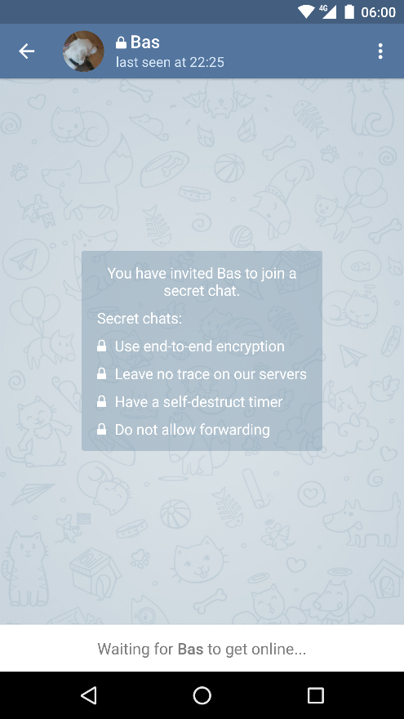
Telegram
Secret chats:
  End-to-end encrypted
  Chats stored only on the devices of sender and receiver
  Cannot be transferred to another device.
  Forwarding is disabled
  Have a self-destruction timer
End-to-end encryption in Telegram is supported also for audio and video calls

Slide 31
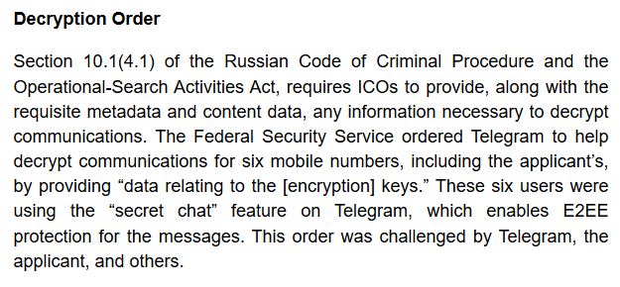
ECHR – Podchasov vs Russia (March 2024)
Podchasov v. Russia (2017–2024)
In 2017, Russia mandated providers like Telegram to:
Store all communication data, including content, for specified periods.
Provide law enforcement with user data, message content, and decryption capabilities.
The FSB ordered Telegram to decrypt messages of six mobile numbers using the secret chat feature on Telegram suspected of terrorism.
Telegram refused, warning that such a backdoor would compromise encryption for all users.
As a consequence:
Telegram was fined and its service was blocked in Russia.
Many users challenged the disclosure orders in Russian courts.
https://www.ejiltalk.org/cracking-the-code-how-podchasov-v-russia-upholds-encryption-and-reshapes-surveillance/
Dmitry Podchasov, a Russian citizen, brought the case to the European Court of Human Rights (ECHR).
He argued that forced decryption violated Article 8 of the ECHR:
  "Everyone has the right to respect for his private and family life, his home and his correspondence."

Slide 32
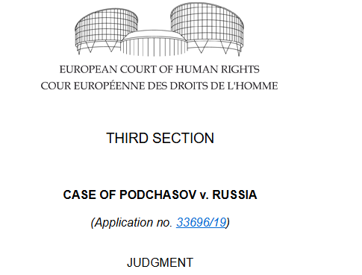
ECHR – Podchasov vs Russia (March 2024)
ECHR Conclusions:
The Court held that the mandate to decrypt E2EE Telegram’s secret chats communications risks weakening the encryption mechanism for all users, which was a disproportionate to the legitimate aims pursued.
Encryption safeguards fundamental rights
Encryption as a shield against abuses
Blanket data retention interferes with the right to privacy
The ECHR conclusions stand in stark contrast to the European Commission’s CSAR proposal, which would compel online services to scan private messages and compare user photos with law enforcement databases.
The debate remains suspended between two opposing needs:
protecting minors and safeguarding privacy.
The Podchasov ruling and multiple security analyses reveal how the Chat Control approach risks being disproportionate and counterproductive.
Instead of guaranteeing greater protection, it could make European citizens more vulnerable.
The future of European regulation will depend on the institutions’ ability to balance security, fundamental rights, and digital trust.
https://hudoc.echr.coe.int/eng/#{%22itemid%22:[%22001-230854%22]}

Slide 33



Thank you for your attention

Slide 34
References
https://breakingdefense.com/2025/04/army-expands-access-to-encrypted-wickr-platform-in-aim-to-curb-insecure-comms-bolster-integration/
https://www.computerweekly.com/news/366632677/Chat-Control-encryption-plans-delayed-after-EU-states-fail-to-agree
https://dig.watch/updates/us-official-advises-encryption-amid-alleged-chinese-hacking-efforts
https://ec.europa.eu/commission/presscorner/detail/en/ip_22_2976
https://ec.europa.eu/commission/presscorner/detail/en/ip_25_920
https://www.eff.org/deeplinks/2023/09/uk-government-knows-how-extreme-online-safety-bill
https://www.eff.org/deeplinks/2024/02/eff-statement-nevadas-attack-end-end-encryption
https://www.eff.org/deeplinks/2024/03/european-court-human-rights-confirms-undermining-encryption-violates-fundamental
https://www.eff.org/deeplinks/2024/10/salt-typhoon-hack-shows-theres-no-security-backdoor-thats-only-good-guys
https://www.eff.org/deeplinks/2025/03/win-encryption-france-rejects-backdoor-mandate
https://www.eff.org/press/releases/reject-nevadas-attack-encrypted-messaging-eff-tells-court
https://www.ejiltalk.org/cracking-the-code-how-podchasov-v-russia-upholds-encryption-and-reshapes-surveillance/
https://www.europarl.europa.eu/doceo/document/E-10-2025-003250_EN.html
https://getsession.org/
https://hudoc.echr.coe.int/eng/#{%22itemid%22:[%22001-230854%22]}
https://www.reuters.com/technology/cybersecurity/chinas-harbin-says-us-launched-advanced-cyber-attacks-winter-games-2025-04-15/
https://support.apple.com/en-us/122234
https://www.theguardian.com/australia-news/2024/apr/29/australias-big-encryption-busting-laws-have-done-little-more-than-give-authorities-the-power-to-ask-nicely
https://www.theguardian.com/australia-news/2024/oct/11/half-of-australias-law-enforcement-agencies-have-banned-officers-using-encrypted-messaging-apps
https://www.theguardian.com/media/2025/mar/17/social-media-companies-fines-uk-illegal-content-online-safety-act
https://www.theguardian.com/technology/2018/dec/08/australias-war-on-encryption-the-sweeping-new-powers-rushed-into-law
https://www.theregister.com/2024/10/07/verizon_att_lumen_salt_typhoon/
https://requestly.com/blog/how-whatsapp-ensures-chat-security-with-end-to-end-encryption/
https://therecord.media/european-commission-takes-aim-encryption-europol-fbi-proposal
https://www.theregister.com/2024/12/05/tmobile_cso_telecom_attack/
https://www.wati.io/blog/understanding-whatsapp-data-security-understand-end-to-end-encryption-and-backups/
https://www.whatsapp.com/security/WhatsApp-Security-Whitepaper.pdf
https://www.wsj.com/tech/cybersecurity/u-s-wiretap-systems-targeted-in-china-linked-hack-327fc63b
Pfefferkorn, R. (2022). Content-oblivious trust and safety techniques: Results from a survey of online service providers. Journal of Online Trust and Safety, 1(2). https://doi.org/10.54501/jots.v1i2.14

