Slide 1
Spin-off dell’Università degli Studi Milano Bicocca
e-privacy XXXIII (2023)
«IA, Tecnologia, Etica e Privacy»
Pisa, 23-24 novembre 2023
Winter edition
Dal principio di precauzione
all’approccio consapevole
La sfida dell’autovalutazione per l’IA
Chiara Vescovi Cyber Law Expert, ReD OPEN PhD Student, Università Milano-Bicocca

Slide 2
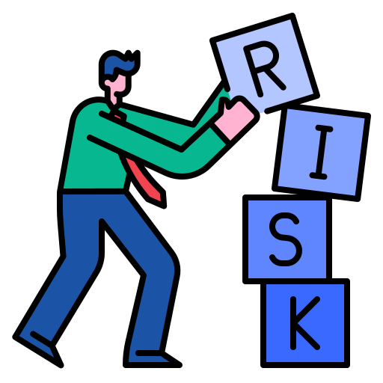
Principio di precauzione in Europa
«Il principio di precauzione è un approccio alla gestione del rischio per cui, qualora sia possibile che una determinata politica o azione possa arrecare danno ai cittadini o all’ambiente e qualora non vi sia ancora un consenso scientifico sulla questione, la politica o l’azione in questione non dovrebbe essere perseguita.»
Art. 191(2), TFUE
La politica dell'Unione in materia ambientale mira a un elevato livello di tutela, tenendo conto della diversità delle situazioni nelle varie regioni dell'Unione. Essa è fondata sui principi della precauzione e dell'azione preventiva, sul principio della correzione, in via prioritaria alla fonte, dei danni causati all'ambiente, nonché sul principio "chi inquina paga".
Fonte: EUR-Lex, Principio di precauzione, disponibile al seguente link: https://eur-lex.europa.eu/legal-content/IT/TXT/?uri=LEGISSUM:precautionary_principle#:~:text=Il%20principio%20di%20precauzione%20%C3%A8,in%20questione%20non%20dovrebbe%20essere

Slide 3
Principio di precauzione in Europa
Strategia di gestione del rischio
Valutazione
Gestione
Comunicazione del rischio.
Prudenza di fronte all’incertezza scientifica
&
Responsabilità eminentemente politica
« un obiettivo è evitare un ingiustificato ricorso al principio di precauzione, che in alcuni casi potrebbe fungere da giustificazione per un protezionismo mascherato. […] È necessario inoltre dissipare una confusione esistente tra l’utilizzazione del principio di precauzione e la ricerca di un livello zero di rischio che, nella realtà, esiste solo raramente»
Fonte: Commissione delle Comunità Europee, Comunicazione della Commissione sul principio di precazione, COM(2000) I final, 2.2.2000, Bruxelles

Slide 4
Precauzione e Innovazione, eterne rivali?
“Is the precautionary principle an obstacle to progress and innovation? How can the PP and the innovation principle reinforce each other? For some, the PP is a source of legal uncertainty and may also undermine progress and innovation by not factoring in the opportunity costs of forgone progress. […] Sunstein has referred to the potential “paralysing effect” of measures underpinned by the precautionary principle”
Fonte: OECD, Understanding and Applying the Precautionary Principle in the Energy Transition, June 2023
Principio di precauzione
«Principio» di innovazione
“Precaution is about steering innovation, not blocking it”
Fonte: Stirling, A. (2016), Precaution in the Governance of Technology. SPRU Working Paper Series

Slide 5
Prendere decisioni: imprescindibile e difficile
Situazione di incertezza scientifica & Responsabilità di prendere una decisione
“The precautionary principle is not, and has never been claimed to be, a definitive decision-making tool, nor a detailed protocol that can be used to determine risks and uncertainties”
“it does provide a general, yet dynamic, normative guide towards effective policymaking in times of uncertainty where the benefit of any doubt should be tilted towards the protection of human health”
Fonte: Botes M. Regulating scientific and technological uncertainty: The precautionary principle in the context of human genomics and AI. S Afr J Sci. 2023;119(5/6)
Notes:
DIGITAL STRATEGY
The Data Act will ensure fairness by setting up rules regarding the use of data generated by Internet of Things (IoT) devices.
the Data Governance Act seeks to strengthen mechanisms to increase data availability and overcome technical obstacles to share and reuse of data. – data altruism
CYBERSECURITY NIS 2
It broadens the scope of NIS1 Directive.
NIS 2 will improve cybersecurity risk management and will introduce reporting obligations across sectors such as energy, transport, health and digital infrastructure; expanfing the new regulatory provisions also to a range of companies not previously included, taking into consideration the companies' sizes and services
DORA
DORA sets uniform requirements for the security of network and information systems of companies and organisations operating in the financial sector as well as critical third parties which provide ICT (Information Communication Technologies)-related services to them, such as cloud platforms or data analytics services. The DORA regulation will become binding as of January 17, 2025, but in the meantime the legal framework will need to be supplemented by regulatory technical standards to be developed by ESMA and finalized by early 2024 at the latest.
Affected operators will benefit from a grace period of 24 months from the effective date of the DORA Regulations to implement all the necessary steps from a technical-organizational point of view to comply with this regulation.
EU CYBERSECURITY ACT
The Cybersecurity Act strengthens the EU Agency for cybersecurity (ENISA) and establishes a cybersecurity certification framework for products and services: companies doing business in the EU will benefit from having to certify their ICT products, processes and services only once and see their certificates recognised across the European Union.
CYBER RESILIENCE ACT
The Cyber Resilience Act seeks to establish common cybersecurity rules for digital products and associated services that are placed on the EU market, it bolsters cybersecurity rules to ensure more secure hardware and software products.
It introduces rules to protect digital products that are not covered by any previous regulation. This way, iit may become (‘the Internet of Things or IoT) legislation in the world.
DIRECTIVE ON THE RESILIENCE OF CRITICAL ENTITIES
The Directive aims to reduce the vulnerabilities and strengthen the resilience of entities providing essential services that are crucial for the maintenance of vital societal functions, economic activities, public health and safety, and the environment (so-called critical entities). They need to be able to prevent, protect against, respond to, cope with and recover from hybrid attacks, natural disasters, terrorist threats and public health emergencies.
DIGITAL SERVICES
DATA SERVICE ACT
The DSA provides specific content moderation, advertising, interface design, and reporting obligations for four categories of services (intermediary, hosting, online platforms and very large online platforms) and the intensity of regulation increases from intermediary services to very large online platforms. – dark patterns
DATA MARKET ACT
The Digital Markets Act aims to ensure that platforms defined as "gatekeepers" behave in a fair way online.
Gatekeepers are large digital platforms providing so called core platform services, such as for example online search engines, app stores, messenger services.
Together with the Digital Services Act, the Digital Markets Act is one of the centrepieces of the European digital strategy.
E-COMMERCE DIRECTIVE
The e-Commerce Directive aims to remove obstacles to cross-border online services.
It is the foundational legal framework for online services in the EU and it sets out basic requirements on mandatory consumer information, steps to follow in online contracting and rules on commercial communications.
AI STRATEGY
AI CONVENTION
The European Commission ('Commission') issued, on 18 August 2022, its Recommendation for a Council Decision Authorising the Opening of Negotiations on behalf of the European Union for a Council of Europe Convention on Artificial Intelligence (AI), Human Rights, Democracy and the Rule of Law, pursuant to Article 218 of the Treaty on the Functioning of the European Union ('TFEU').
DATI NON PERSONALI
Regulation on a framework for the free flow of non-personal data in the EU
The General Data Protection Regulation (GDPR) already provides for the free movement of personal data within the EU. This Regulation will therefore ensure a comprehensive and coherent approach to the free movement of all data in the EU.

Slide 6
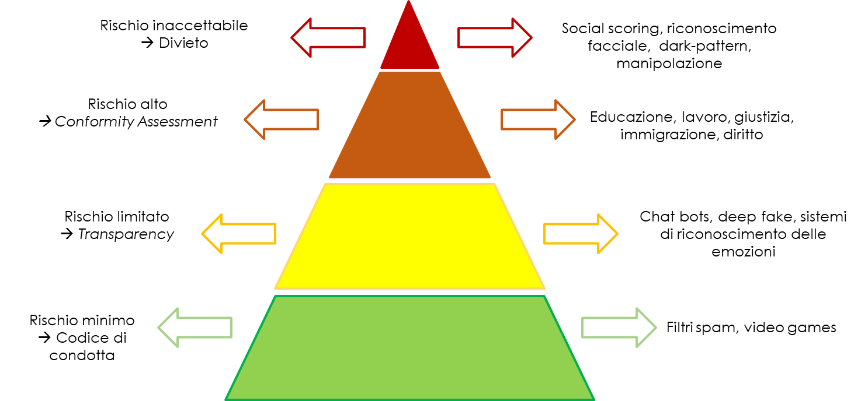
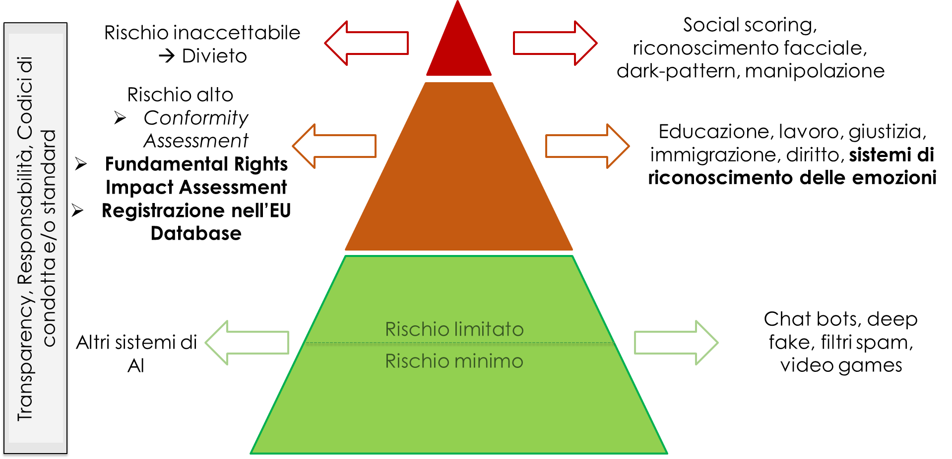
L’AI Act e il «risk-based approach»
Versione aprile 2021
Versione maggio 2023
Notes:
DIGITAL STRATEGY
The Data Act will ensure fairness by setting up rules regarding the use of data generated by Internet of Things (IoT) devices.
the Data Governance Act seeks to strengthen mechanisms to increase data availability and overcome technical obstacles to share and reuse of data. – data altruism
CYBERSECURITY NIS 2
It broadens the scope of NIS1 Directive.
NIS 2 will improve cybersecurity risk management and will introduce reporting obligations across sectors such as energy, transport, health and digital infrastructure; expanfing the new regulatory provisions also to a range of companies not previously included, taking into consideration the companies' sizes and services
DORA
DORA sets uniform requirements for the security of network and information systems of companies and organisations operating in the financial sector as well as critical third parties which provide ICT (Information Communication Technologies)-related services to them, such as cloud platforms or data analytics services. The DORA regulation will become binding as of January 17, 2025, but in the meantime the legal framework will need to be supplemented by regulatory technical standards to be developed by ESMA and finalized by early 2024 at the latest.
Affected operators will benefit from a grace period of 24 months from the effective date of the DORA Regulations to implement all the necessary steps from a technical-organizational point of view to comply with this regulation.
EU CYBERSECURITY ACT
The Cybersecurity Act strengthens the EU Agency for cybersecurity (ENISA) and establishes a cybersecurity certification framework for products and services: companies doing business in the EU will benefit from having to certify their ICT products, processes and services only once and see their certificates recognised across the European Union.
CYBER RESILIENCE ACT
The Cyber Resilience Act seeks to establish common cybersecurity rules for digital products and associated services that are placed on the EU market, it bolsters cybersecurity rules to ensure more secure hardware and software products.
It introduces rules to protect digital products that are not covered by any previous regulation. This way, iit may become (‘the Internet of Things or IoT) legislation in the world.
DIRECTIVE ON THE RESILIENCE OF CRITICAL ENTITIES
The Directive aims to reduce the vulnerabilities and strengthen the resilience of entities providing essential services that are crucial for the maintenance of vital societal functions, economic activities, public health and safety, and the environment (so-called critical entities). They need to be able to prevent, protect against, respond to, cope with and recover from hybrid attacks, natural disasters, terrorist threats and public health emergencies.
DIGITAL SERVICES
DATA SERVICE ACT
The DSA provides specific content moderation, advertising, interface design, and reporting obligations for four categories of services (intermediary, hosting, online platforms and very large online platforms) and the intensity of regulation increases from intermediary services to very large online platforms. – dark patterns
DATA MARKET ACT
The Digital Markets Act aims to ensure that platforms defined as "gatekeepers" behave in a fair way online.
Gatekeepers are large digital platforms providing so called core platform services, such as for example online search engines, app stores, messenger services.
Together with the Digital Services Act, the Digital Markets Act is one of the centrepieces of the European digital strategy.
E-COMMERCE DIRECTIVE
The e-Commerce Directive aims to remove obstacles to cross-border online services.
It is the foundational legal framework for online services in the EU and it sets out basic requirements on mandatory consumer information, steps to follow in online contracting and rules on commercial communications.
AI STRATEGY
AI CONVENTION
The European Commission ('Commission') issued, on 18 August 2022, its Recommendation for a Council Decision Authorising the Opening of Negotiations on behalf of the European Union for a Council of Europe Convention on Artificial Intelligence (AI), Human Rights, Democracy and the Rule of Law, pursuant to Article 218 of the Treaty on the Functioning of the European Union ('TFEU').
DATI NON PERSONALI
Regulation on a framework for the free flow of non-personal data in the EU
The General Data Protection Regulation (GDPR) already provides for the free movement of personal data within the EU. This Regulation will therefore ensure a comprehensive and coherent approach to the free movement of all data in the EU.

Slide 7
L’AI Act e il «risk-based approach»
Rischio inaccettabile
Divieto
(con eccezioni)
Social scoring, riconoscimento facciale, dark-pattern, manipolazione
Direttiva sulla sicurezza generale dei prodotti
Es. giocattoli, aviazione, automobili, dispositivi medici e ascensori.
Rischio alto
→ Fundamental Rights Impact Assessment
identificazione biometrica, infrastrutture critiche, istruzione, occupazione, servizi essenziali e servizi pubblici, forze dell'ordine, migrazioni, interpretazione e applicazione della legge.
Aree da registrare
General- Purpose AI
AI generativa
Foundation models
Rischio
limitato
Chat bots, deep fake, filtri spam, video games
Transparency, Responsabilità, Codici di condotta e/o standard
«Layered Regulation»
Fonte: EPRS, Artificial Intelligence Act, June 2023 Parlamento Europeo, «Normativa sull'IA: la prima regolamentazione sull'intelligenza artificiale», link: https://www.europarl.europa.eu/news/it/headlines/society/20230601STO93804/normativa-sull-ia-la-prima-regolamentazione-sull-intelligenza-artificiale
Notes:
General-purpose AI, generative AI and foundation models. Parliament sets a layered regulation of general-purpose AI. Parliament imposes an obligation on providers of foundation models to ensure robust protection of fundamental rights, health, safety, the environment, democracy and the rule of law. They would be required to assess and mitigate the risks their models entail, comply with some design, information and environmental requirements and register such models in an EU database. Furthermore, generative foundation AI models (such as ChatGPT) that use large language models (LLMs) to generate art, music and other content would be subject to stringent transparency obligations. Providers of such models and of generative content would have to disclose that the content was generated by AI not by humans, train and design their models to prevent generation of illegal content and publish information on the use of training data protected under copyright law. Finally, all foundation models should provide all necessary information for downstream providers to be able to comply with their obligations under the AI act.

Slide 8
Una soluzione percorribile?
Dal principio di precauzione all’approccio consapevole – Dott.ssa Chiara Vescovi

Slide 9
Continuare a decidere nell’incertezza
Individuare eventuali rischi
Identificare tempestivamente nuove opportunità di business e crescita
Adattare la tecnologia a requisiti tecnici e normativi
Dal principio di precauzione all’approccio consapevole – Dott.ssa Chiara Vescovi
Notes:
Mettere qualche altro grassetto

Slide 10
La consapevolezza come chiave di volta
Consapevolezza
Olistica
Tempestiva
Dal principio di precauzione all’approccio consapevole – Dott.ssa Chiara Vescovi
Notes:
Consapevolezza (guardarsi allo specchio)
Che fosse olistica → più elementi di valutazione
Tempestica → per gestire l’incertezza scientifica in un mondo che non si ferma

Slide 11
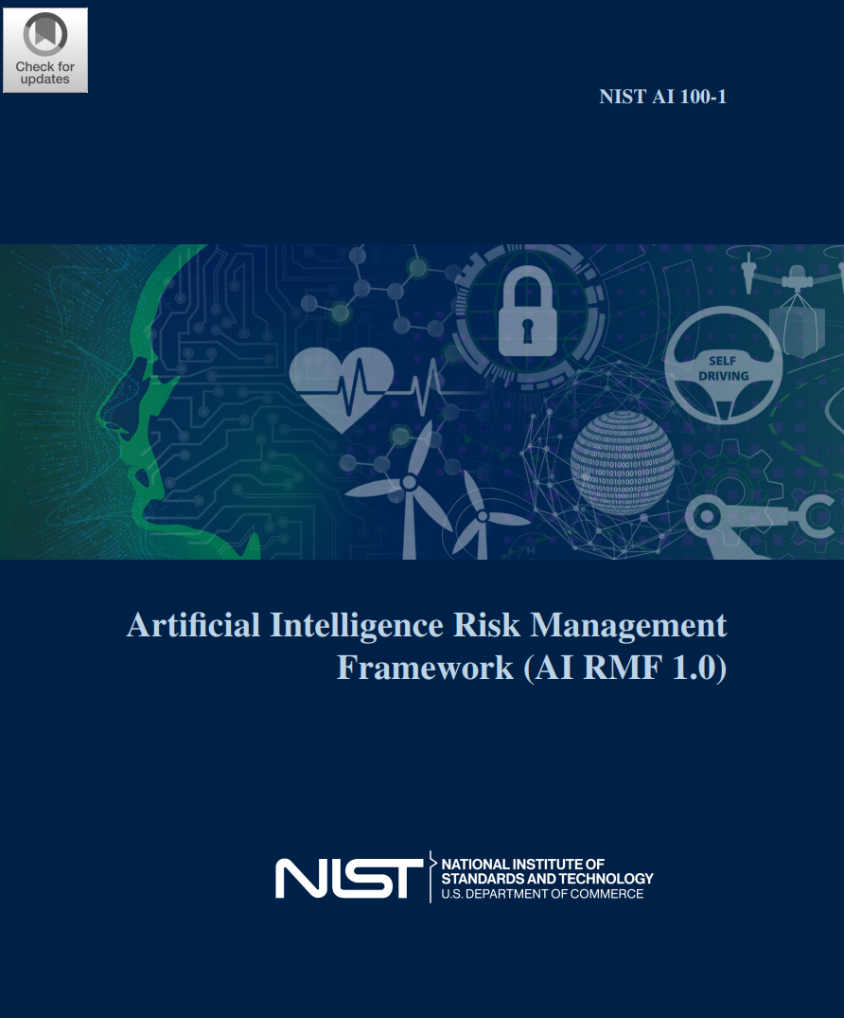
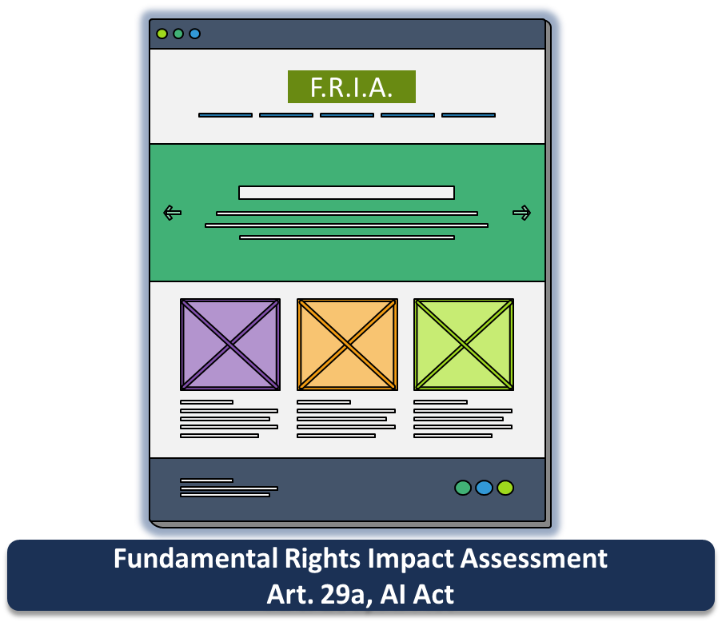
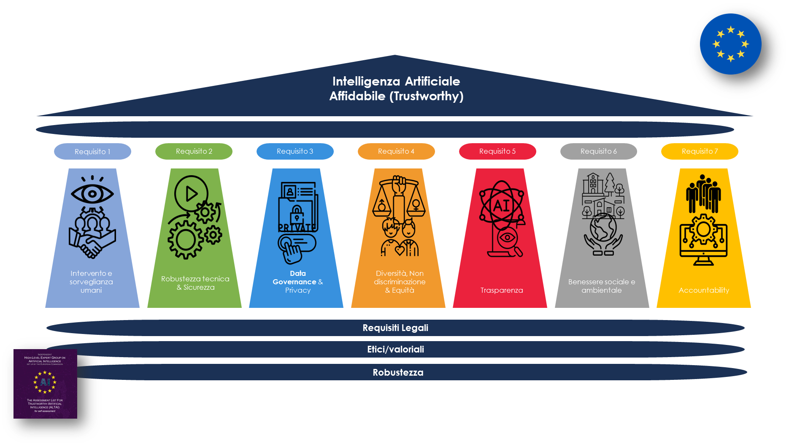
La consapevolezza come chiave di volta
Autovalutazione
Percorso di aggiornamento
Dal principio di precauzione all’approccio consapevole – Dott.ssa Chiara Vescovi

Slide 12
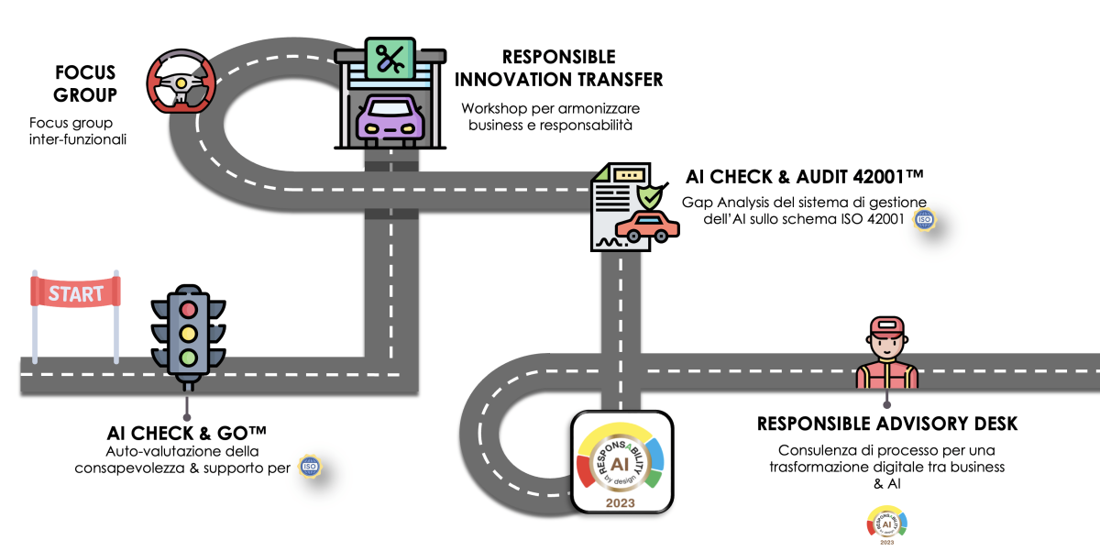
Autovalutazione: un percorso di consapevolezza
Al termine del percorso verrà rilasciata la attestazione generale ResponsAbility by DesignTM
AI DIGITAL SONAR
Servizio di ricerca e formazione permanente per aziende responsabili

Slide 13
L’approccio ResponsAbility by Design™
Centralità della persona
Data Governance
Requisiti normativi
Certificazioni
Efficientamento
Sanzioni
Digitalizzazione
Responsabilità
Governance
Trasformazione digitale
Partecipazione della persona
Consapevolezza
Sostenibilità
Strategia
Non-discriminazioni

Slide 14
Spin-off dell’Università degli Studi Milano Bicocca
Grazie dell’attenzione!
chiara.vescovi@redopen.it
chiara.vescovi@unimib.it

Slide 15
ReD OPEN: Chi siamo
ReD OPEN è uno spin-off dell’Università degli Studi Milano Bicocca che ha sviluppato gli strumenti AI Check & Go™ e AI Check & Audit™.
Dal 2019 ReD OPEN sostiene la diffusione di un approccio consapevole e responsabile alla trasformazione digitale, nella progettazione e nell’utilizzo di strumenti di Intelligenza Artificiale. ReD OPEN ha anche un suo centro di competenza che ha la missione di potenziare le aziende, comunità e associazioni che affrontano il digitale secondo principi etici e di responsabilità sociale.
Il team e il comitato scientifico
www.redopen.it/team/
Accademia
La nostra storia
Impresa
www.redopen.it/timeline/

